Slide 1


Slide 2
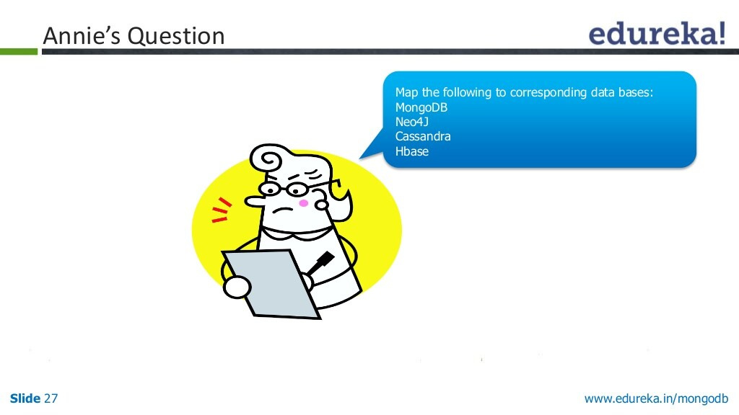

Slide 3
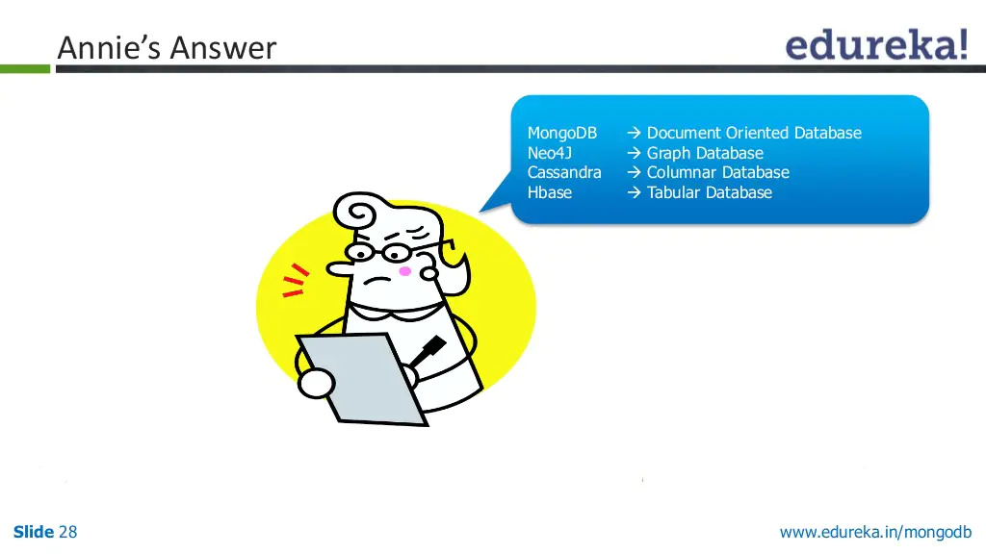

Slide 4
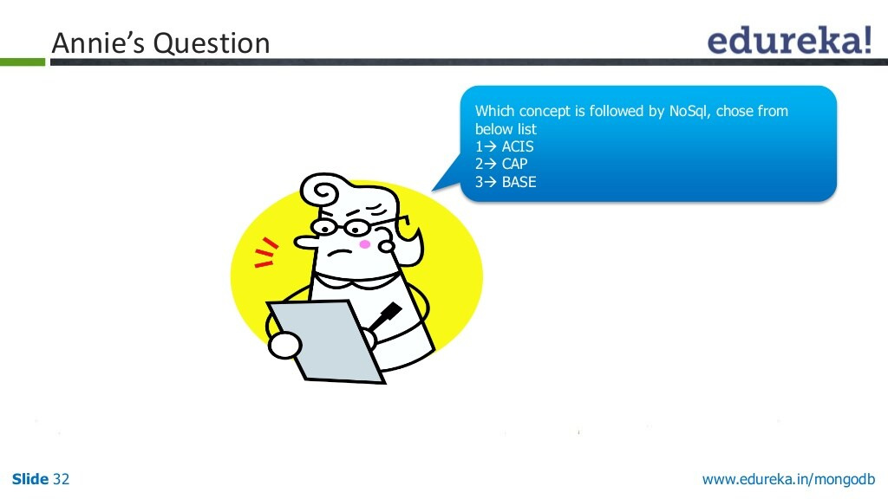

Slide 5


Slide 6
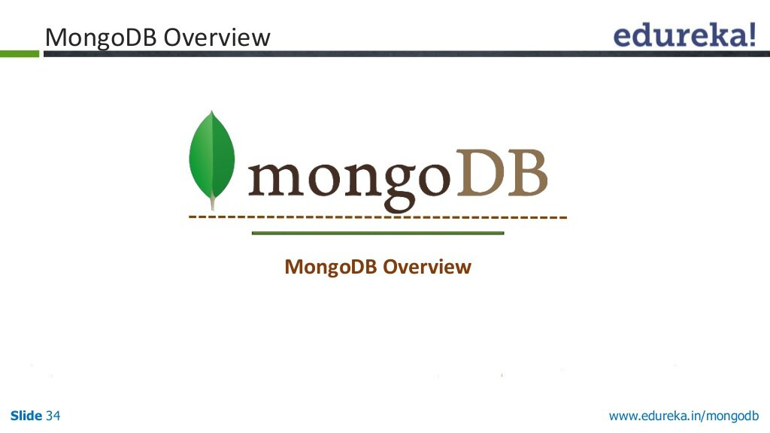

Slide 7
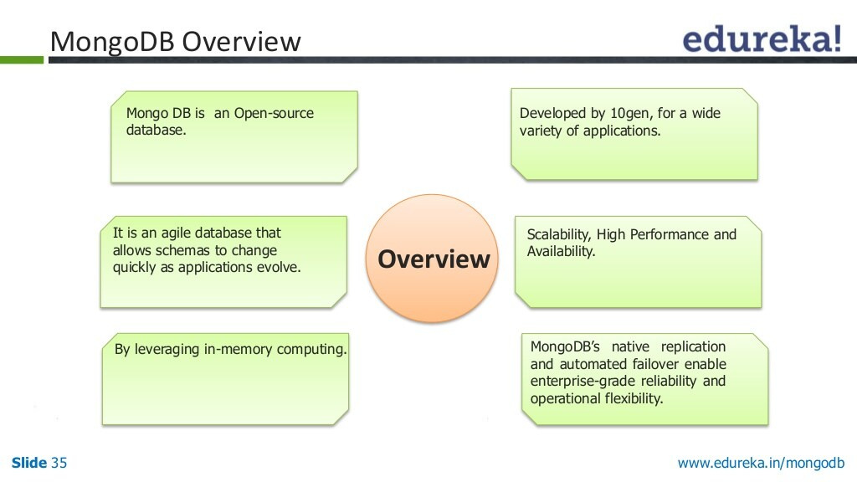

Slide 8
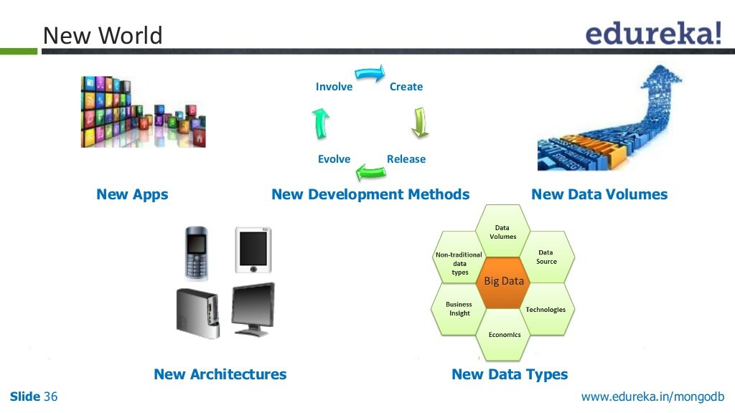

Slide 9
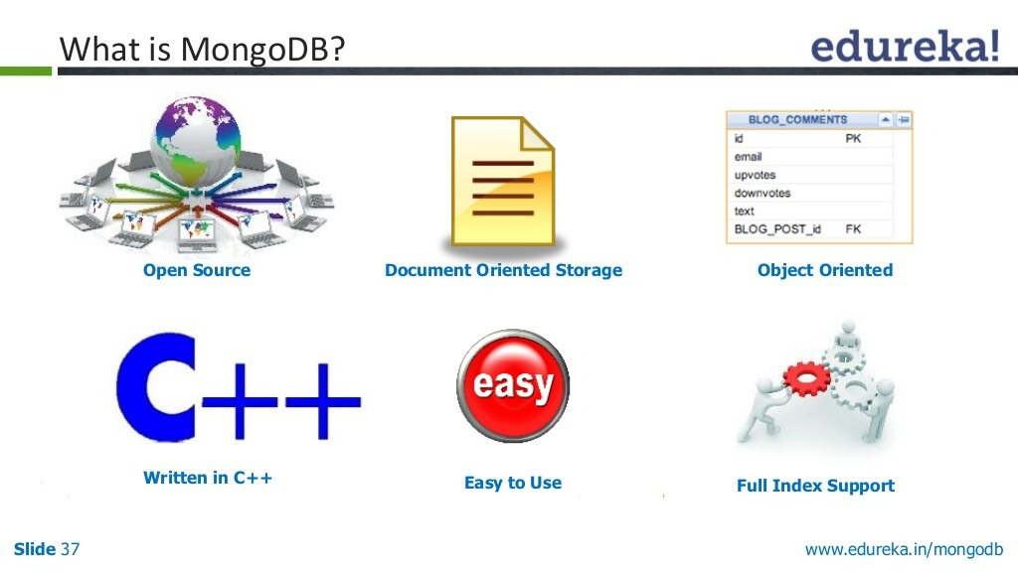

Slide 10
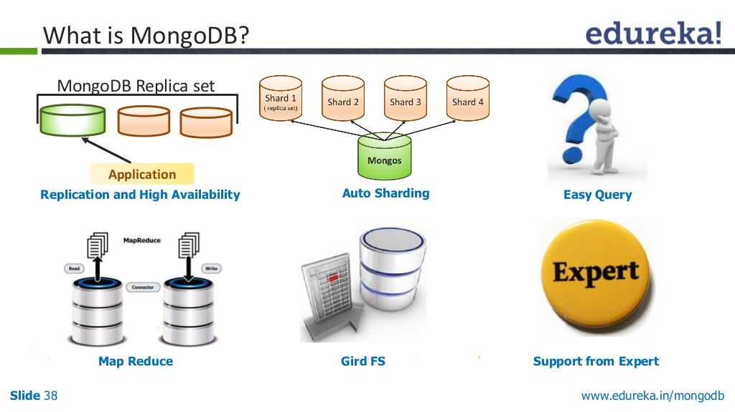

Slide 11
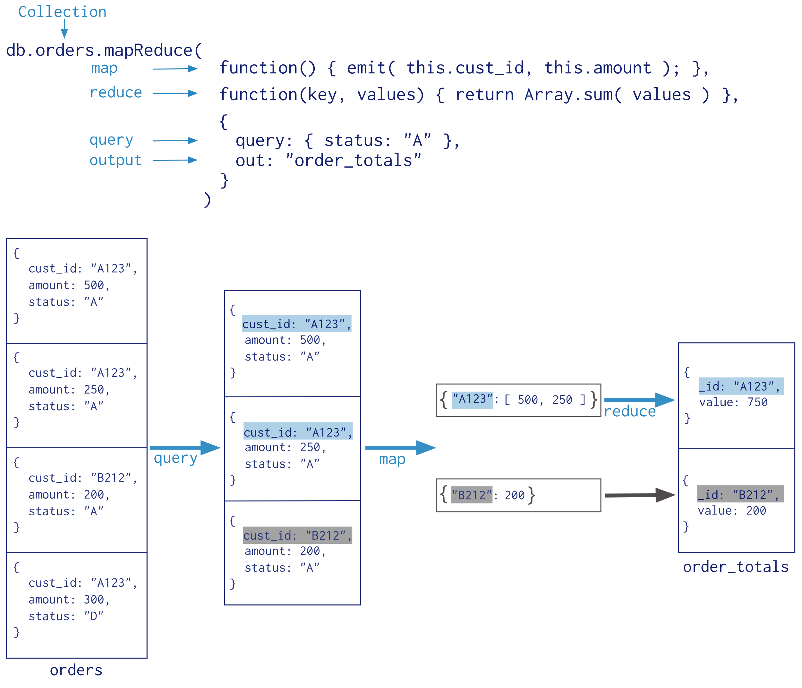
MapReduce support

Slide 12


Slide 13
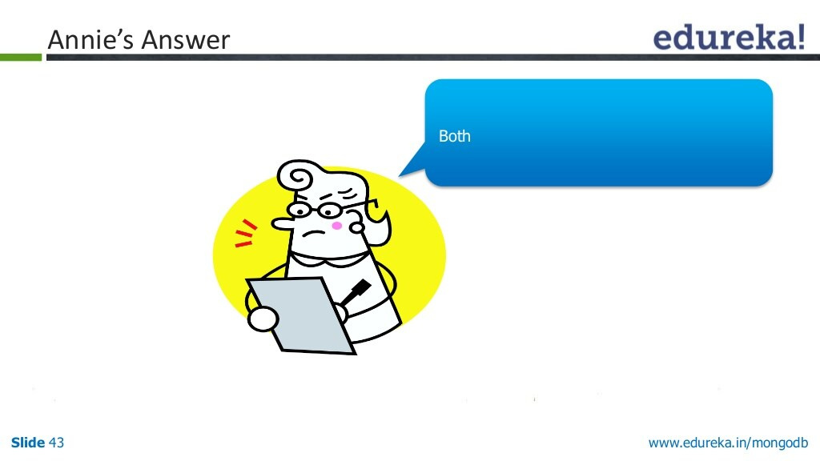

Slide 14
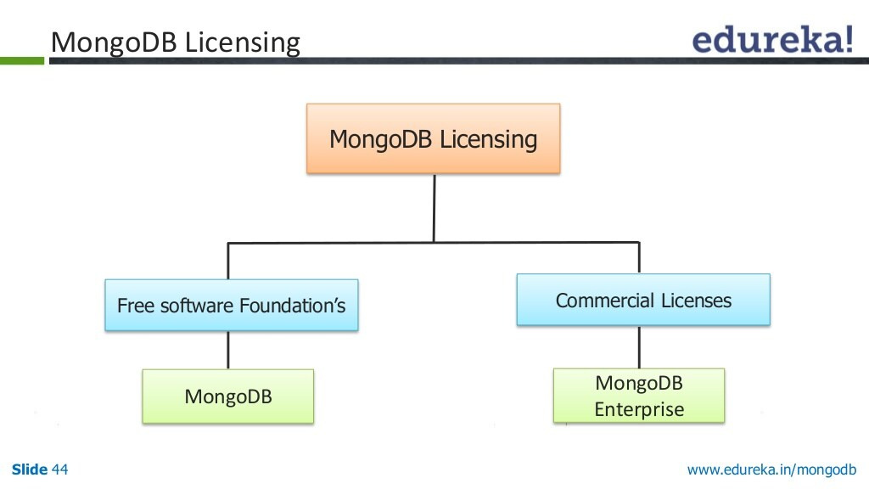

Slide 15
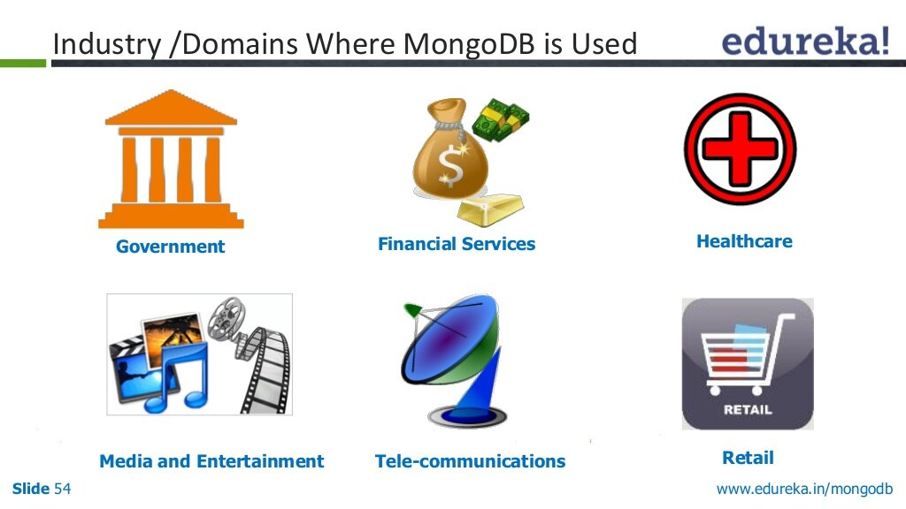

Slide 16
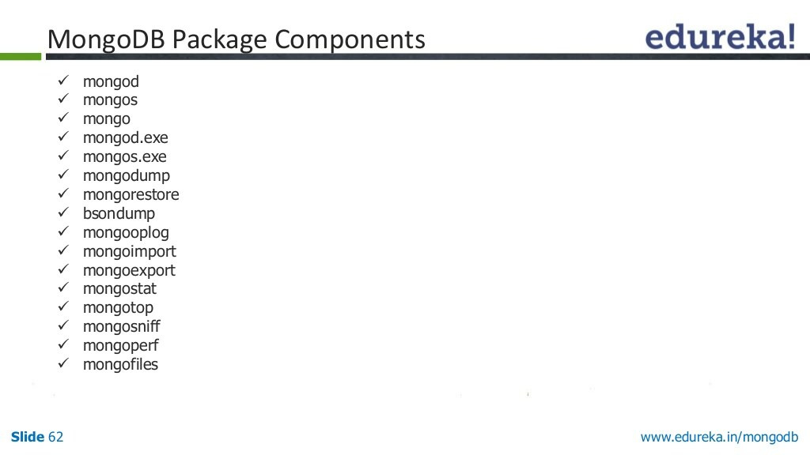

Slide 17
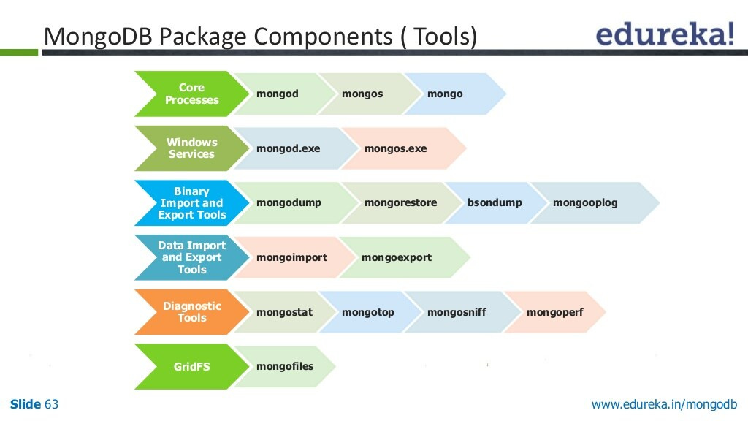

Slide 18
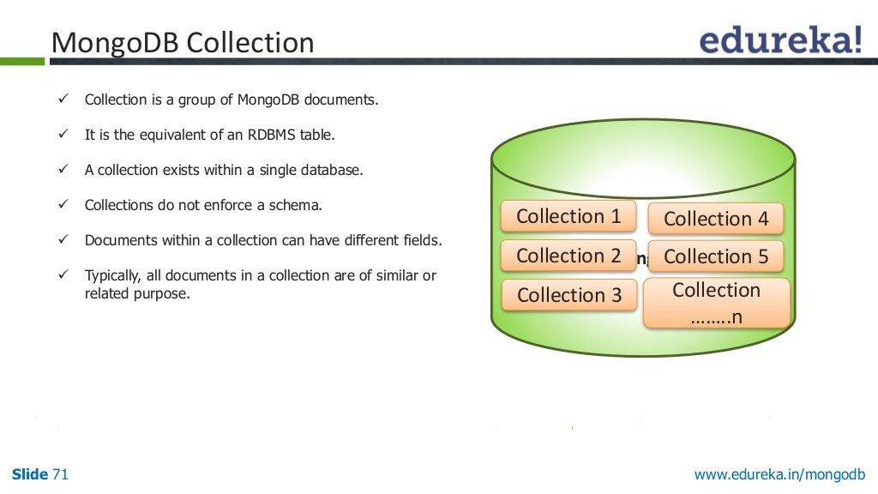

Slide 19
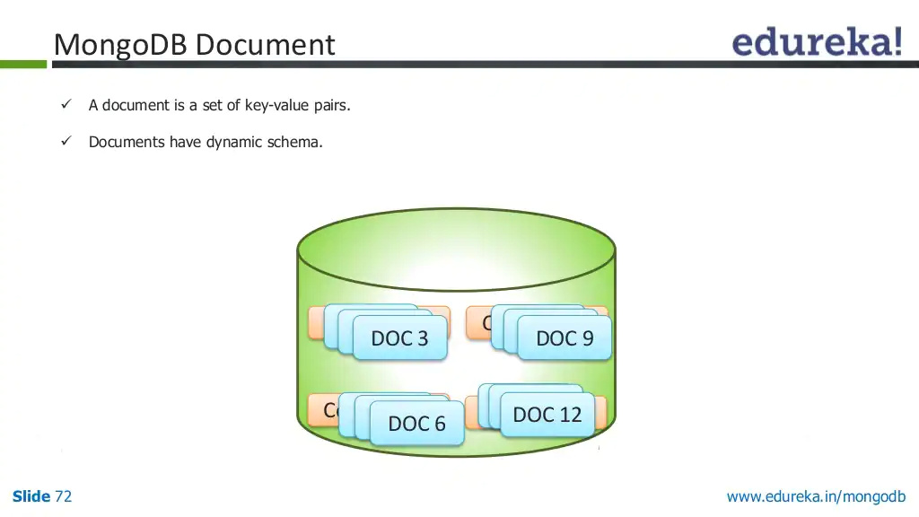

Slide 20
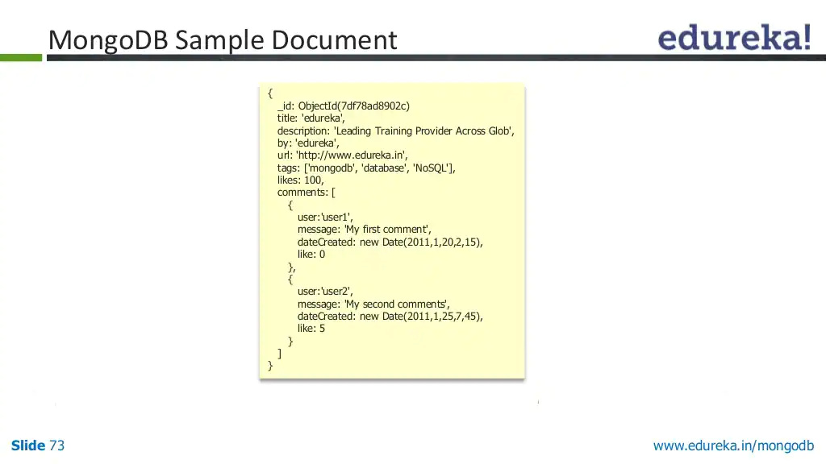

Slide 21
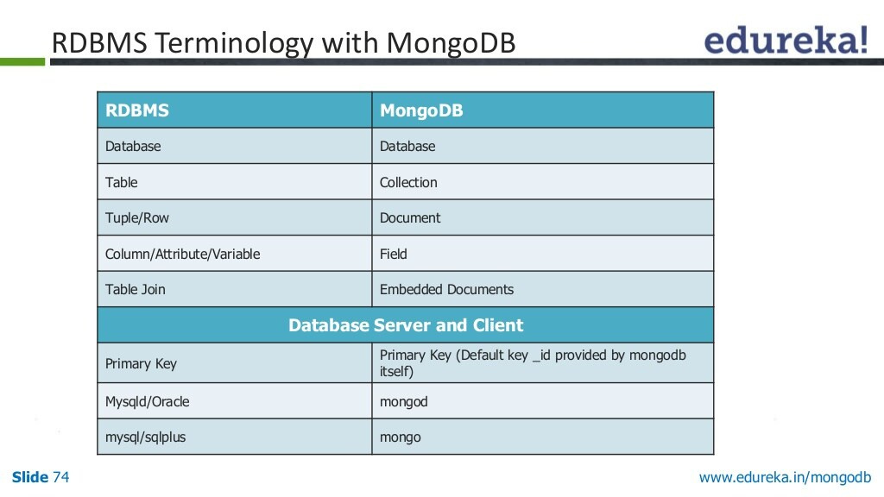

Slide 22
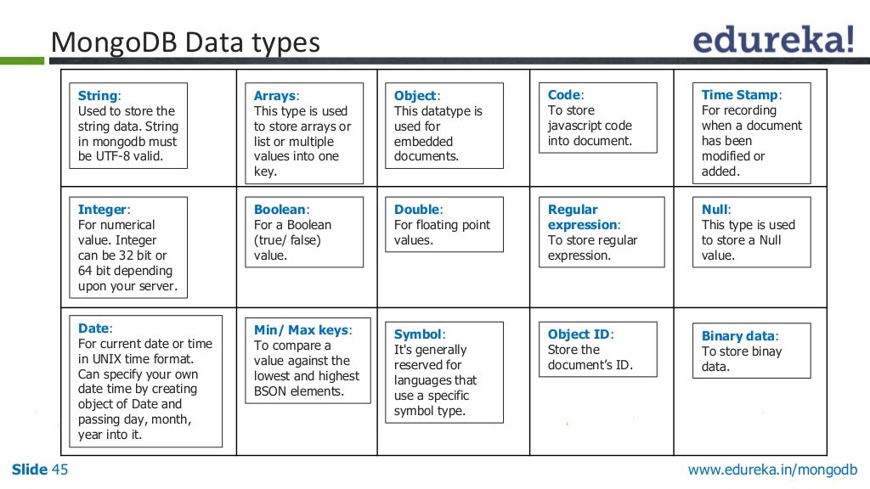

Slide 23
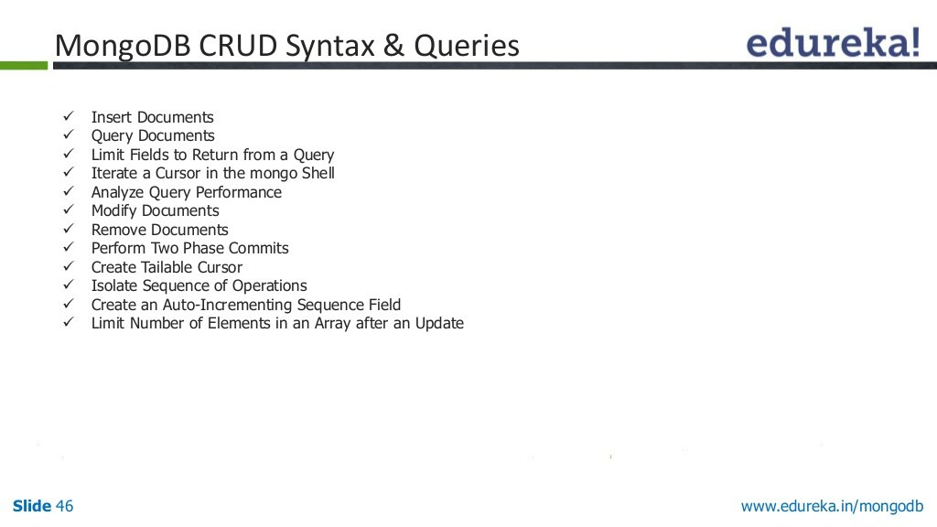

Slide 24
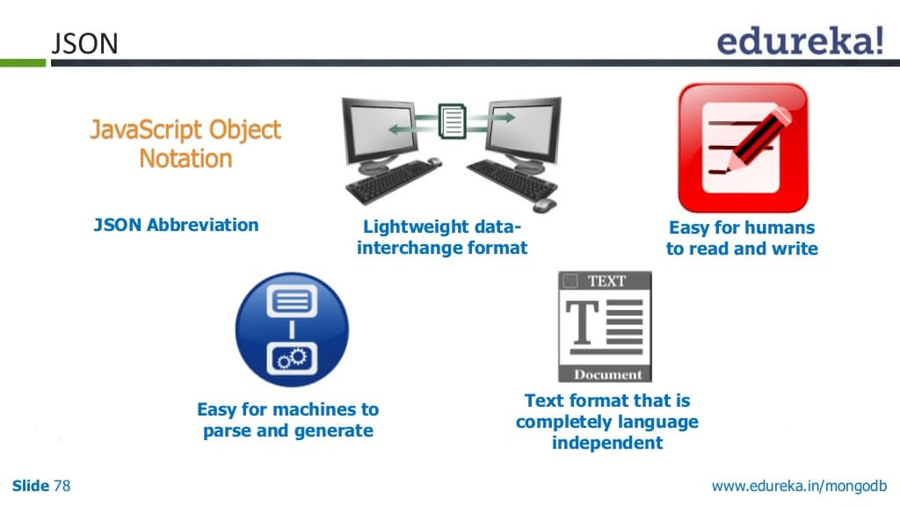

Slide 25
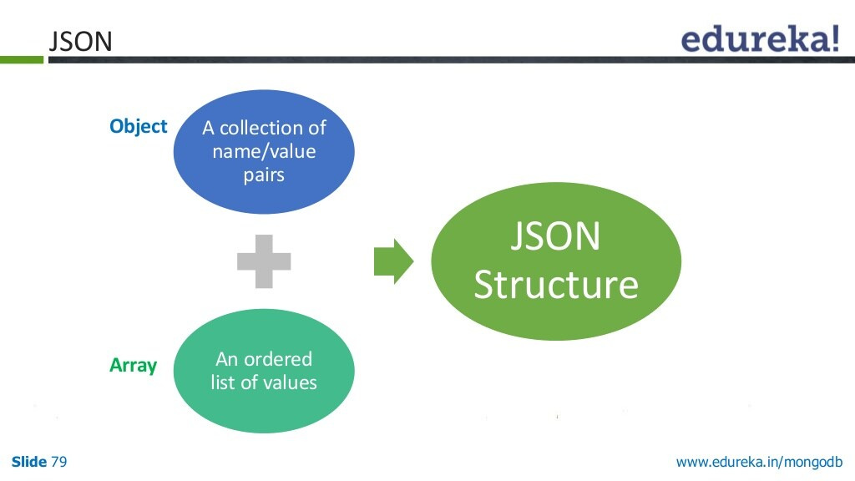

Slide 26
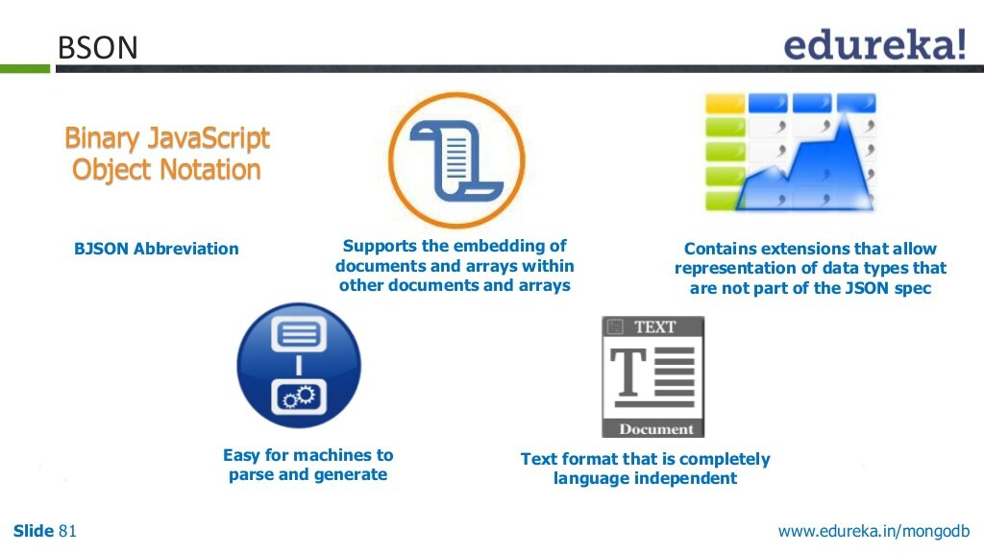

Slide 27
JSON and BSON format
{"hello": "world"} →
\x16\x00\x00\x00 // total document size
\x02 // 0x02 = type String
hello\x00 // field name
\x06\x00\x00\x00world\x00 // field value
\x00 // 0x00 = type EOO ('end of object')
{"BSON": ["awesome", 5.05, 1986]} →
\x31\x00\x00\x00
\x04BSON\x00
\x26\x00\x00\x00
\x02\x30\x00\x08\x00\x00\x00awesome\x00
\x01\x31\x00\x33\x33\x33\x33\x33\x33\x14\x40
\x10\x32\x00\xc2\x07\x00\x00
\x00
\x00

Slide 28
 | JSON | BSON
Type | JSON files are written in text format. | BSON files are written in binary.
Speed | JSON is fast to read but slower to build. | BSON is slow to read but faster to build and scan.
Space | JSON data is slightly smaller in byte size. | BSON data is slightly larger in byte size.
Encode and Decode | We can send JSON through APIs without encoding and decoding. | BSON files are encoded before storing and decoded before displaying.
Parse | JSON is a human-readable format that doesn't require parsing. | BSON needs to be parsed as they are machine-generated and not human-readable.
Data Types | JSON has a specific set of data types—string, boolean, number for numeric data types, array, object, and null. | Unlike JSON, BSON offers additional data types such as bindata for binary data, decimal128 for numeric.
Usage | Used to send data through the network (mostly through APIs). | Databases use BSON to store data.

Slide 29
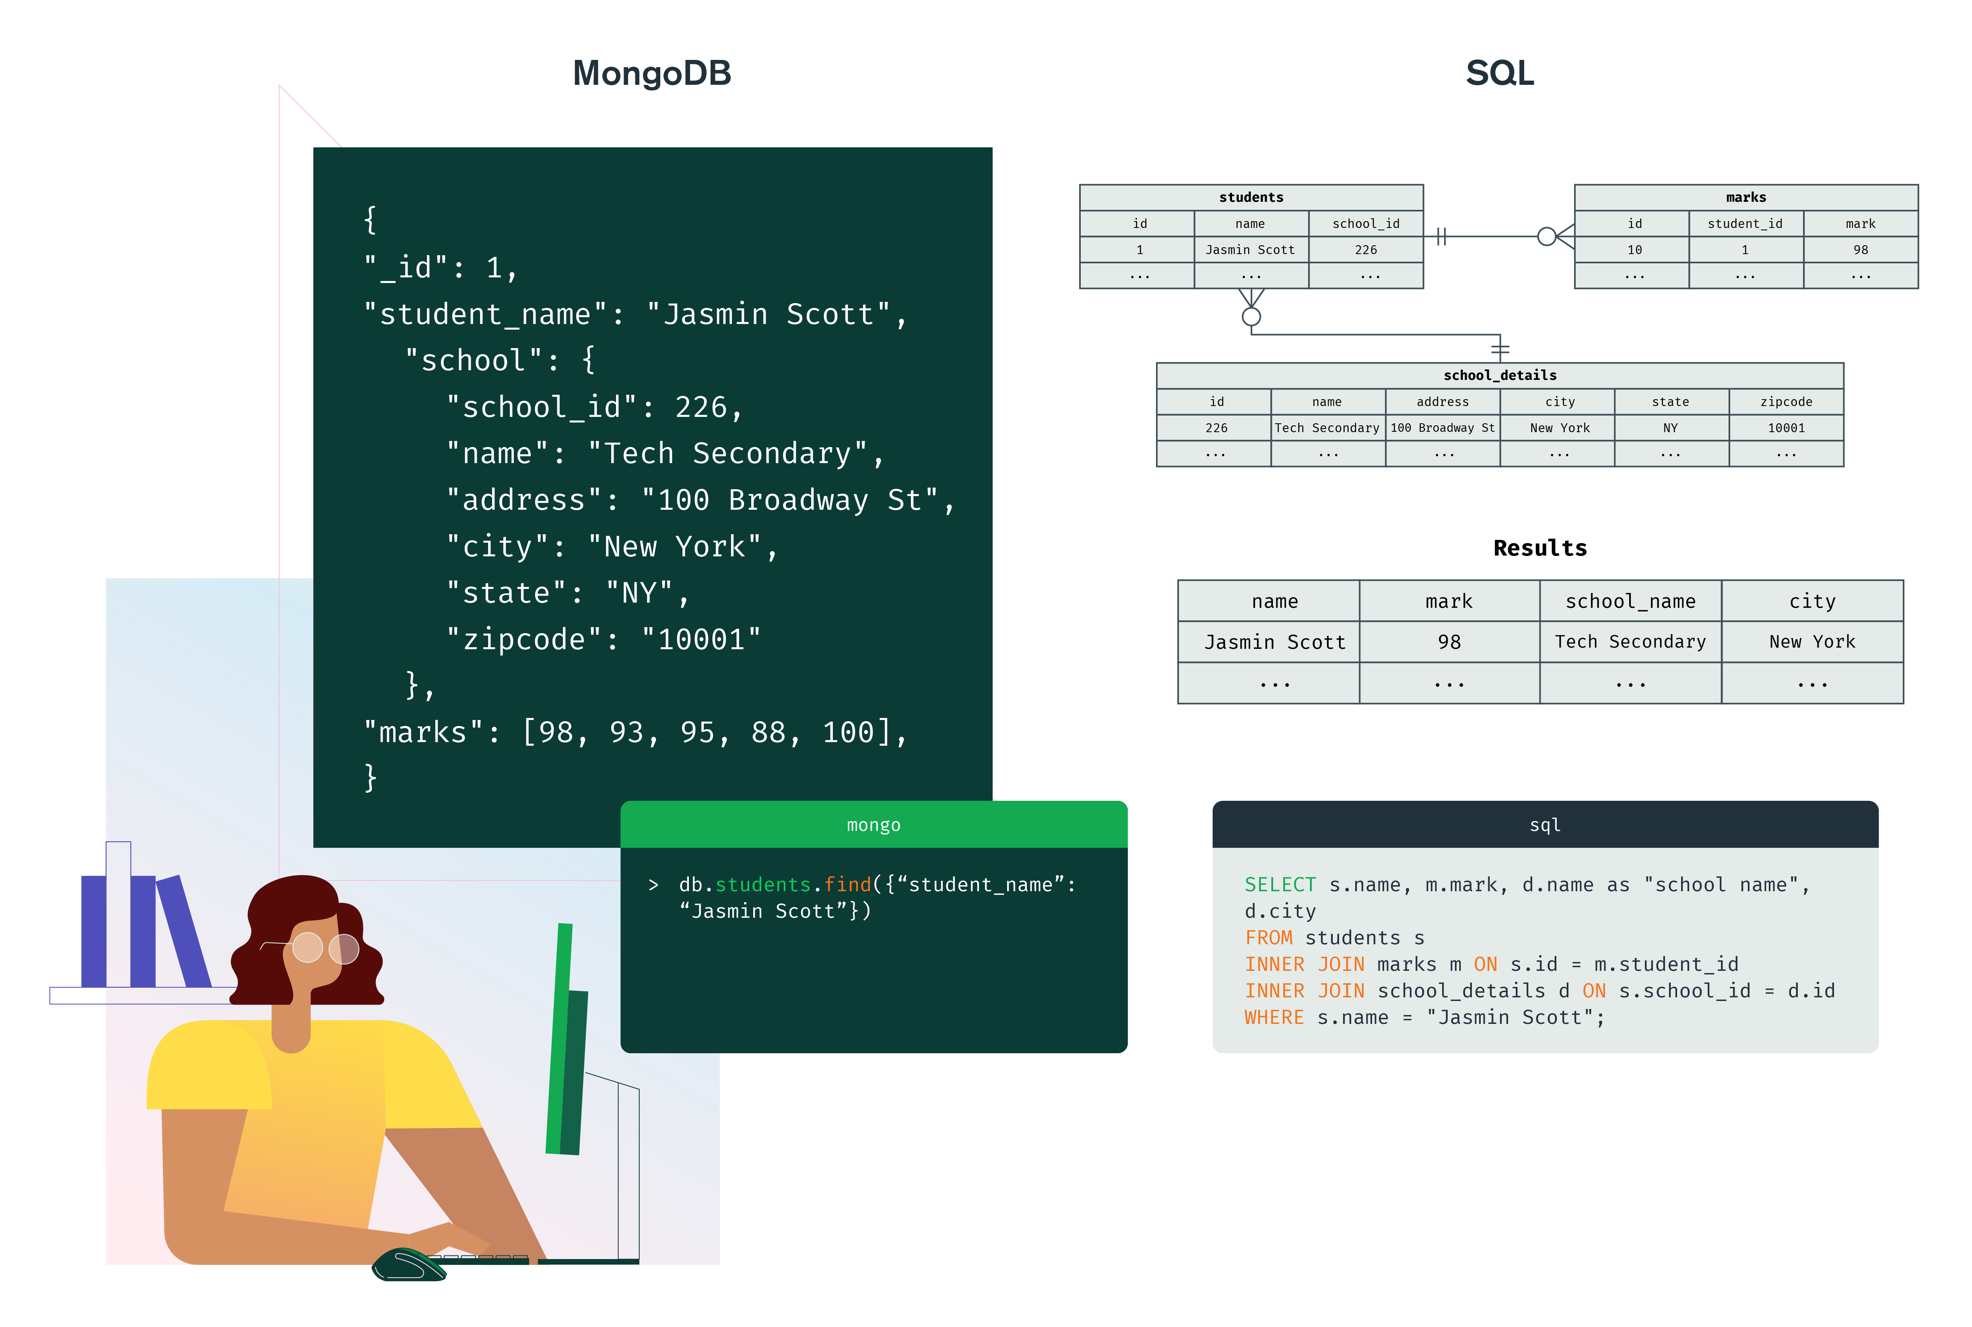
SQL vs MongoDB

Slide 30
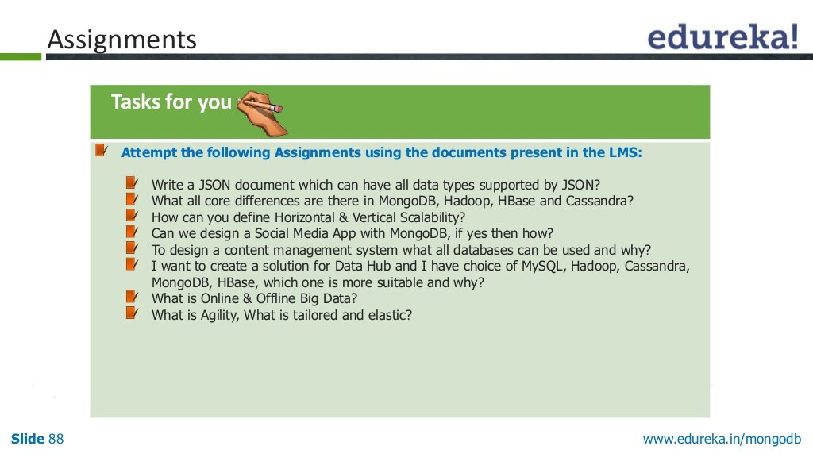

Slide 31


Slide 32


Slide 33
